Slide 1

AIM OF VT PROJECT To expose the best combination for strategy games available in the App Store in order to get a good user rating (4.0/5.0 and above).
Institute /Company Name:COURSERA
Resource Person: EMILY FOX
Duration: 2 MONTHS
Student Name : N DEEPIKA
Section : B
University Roll No: 301402219092

Slide 2

Vocational Training Certificate

Slide 3
Technology Used
Python
Numpy
Pandas
Matplotlib
Plotly

Slide 4
Project Description :
App Store
Game
Dataset
Data
Cleaning
Update Date Column
Genre
Grouping
Game Size Analysis
Game Price and In-App Purchase Factor
Non Necessary
Columns
Puzzle
Puzzle
Board
Games without
User Rating
Action
Adventure
Adventure
Role
User Rating<200 and
Update Date<6 months
Role Playing
Most Expensive
Games
Family
Family
Education

Slide 5
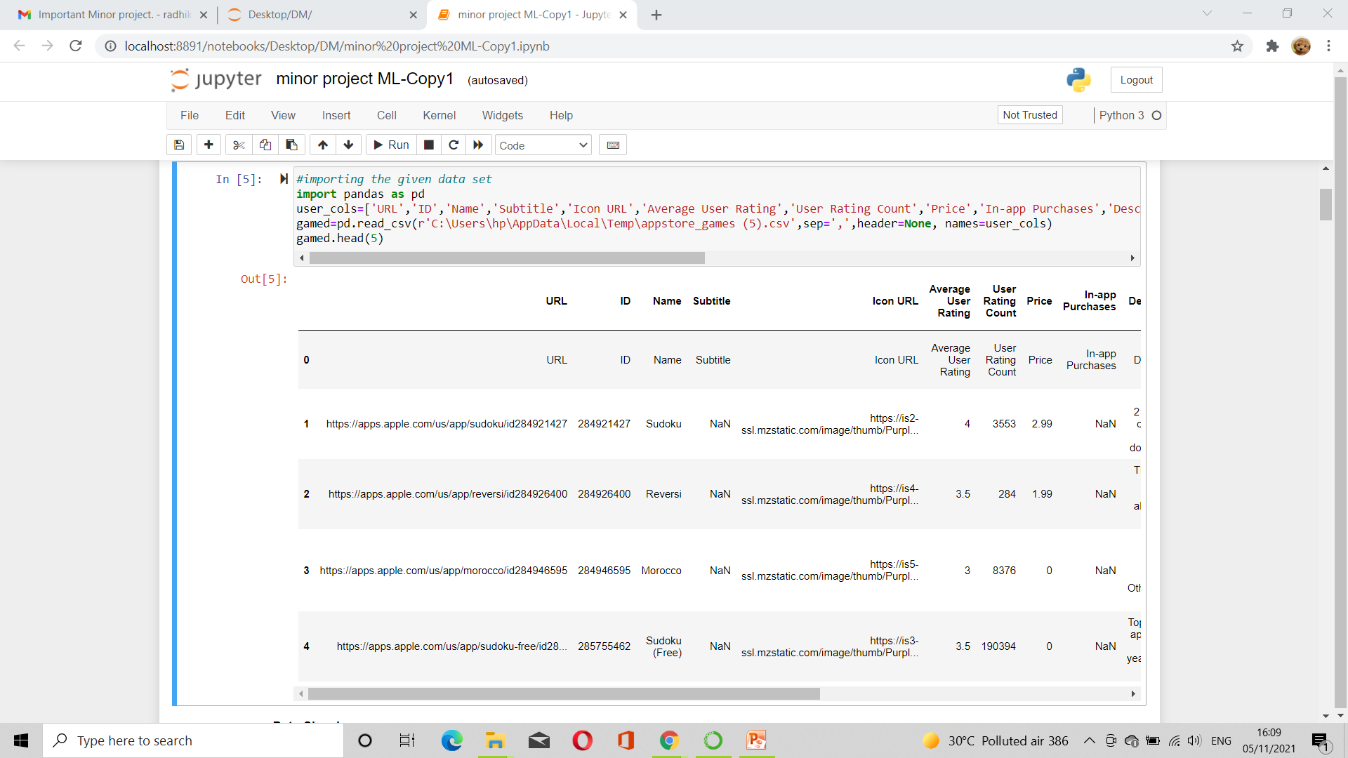
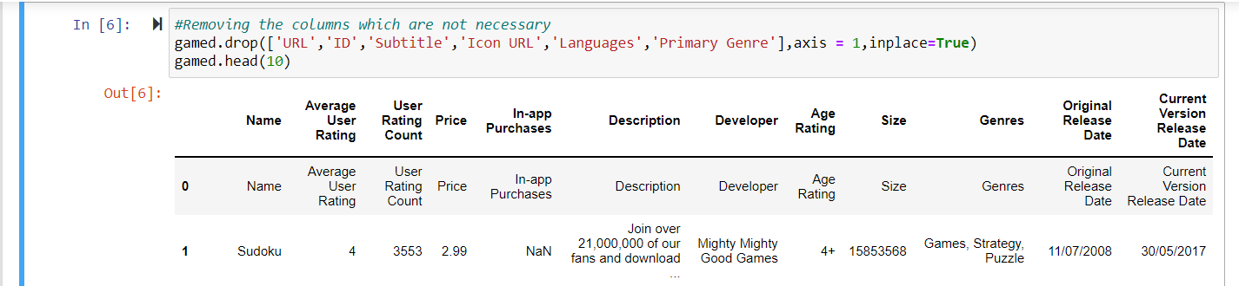
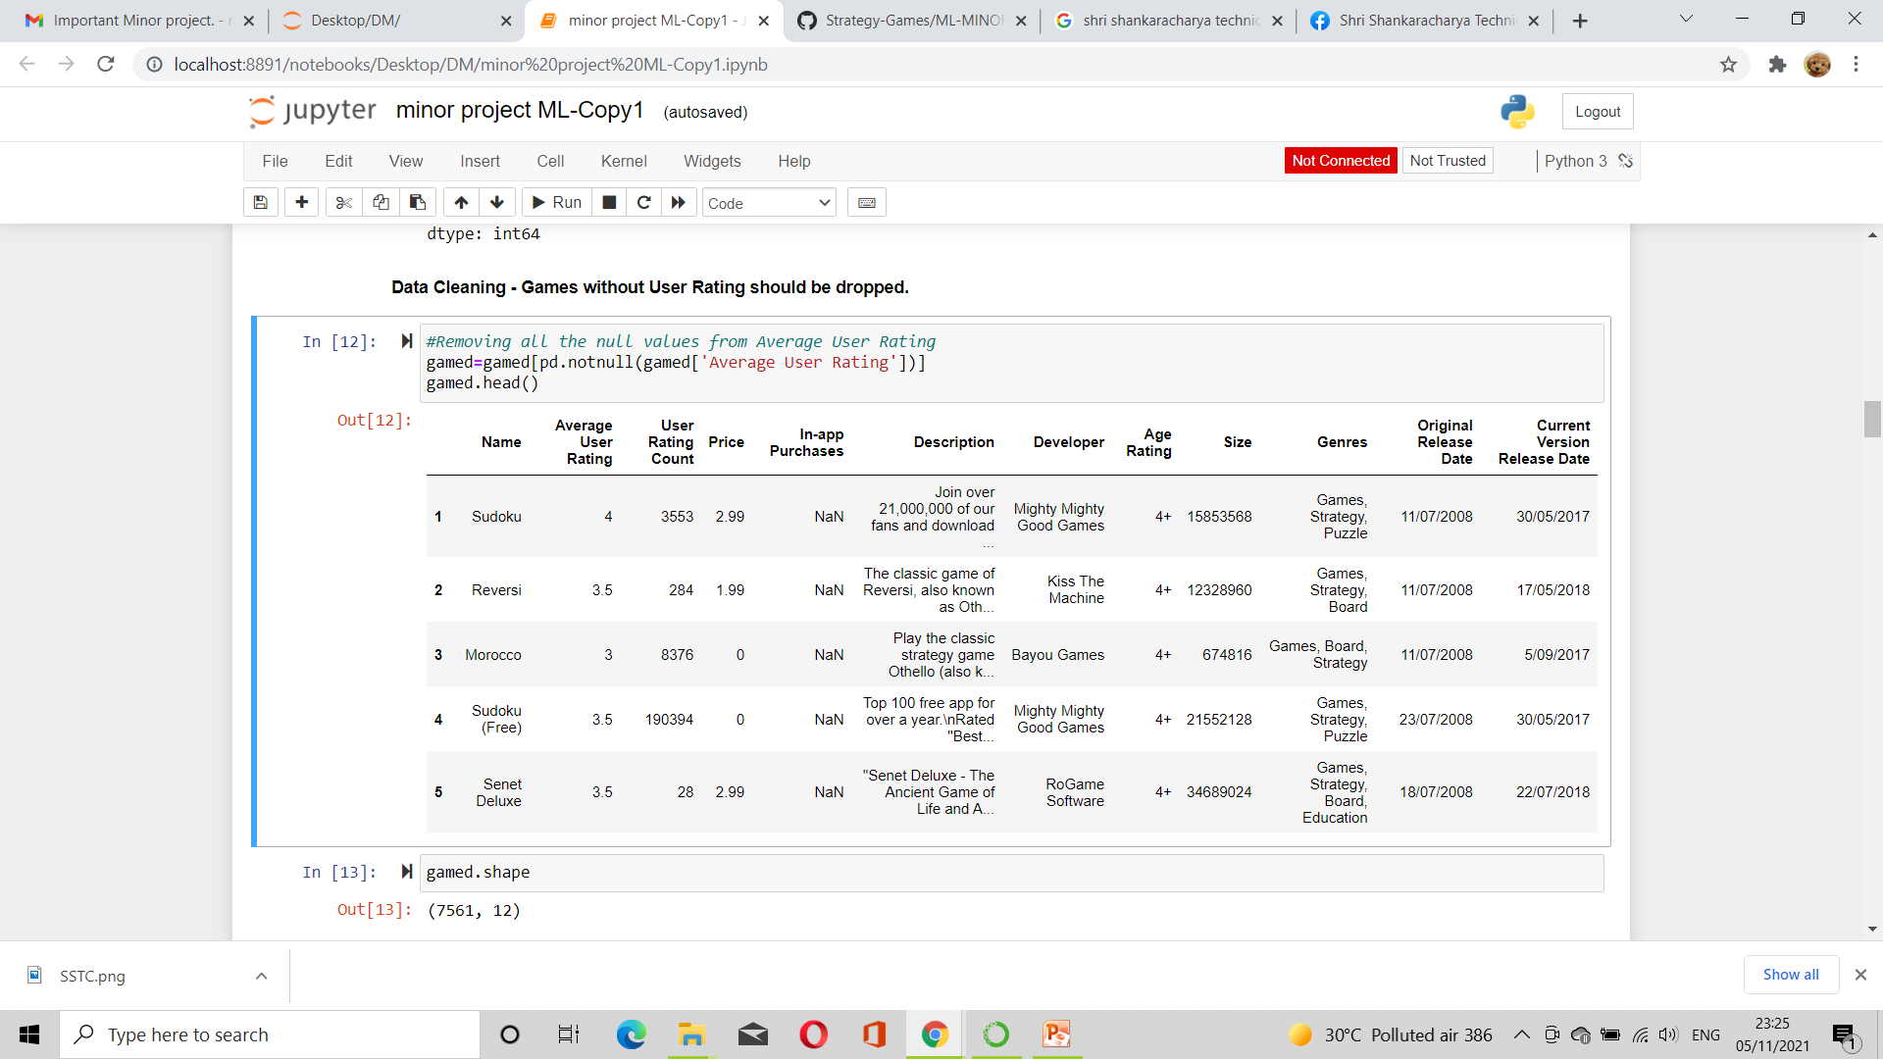
Importing the dataset:
Removing Non necessary columns:
(17008, 12)
Removing Apps with no user rating:

Slide 6
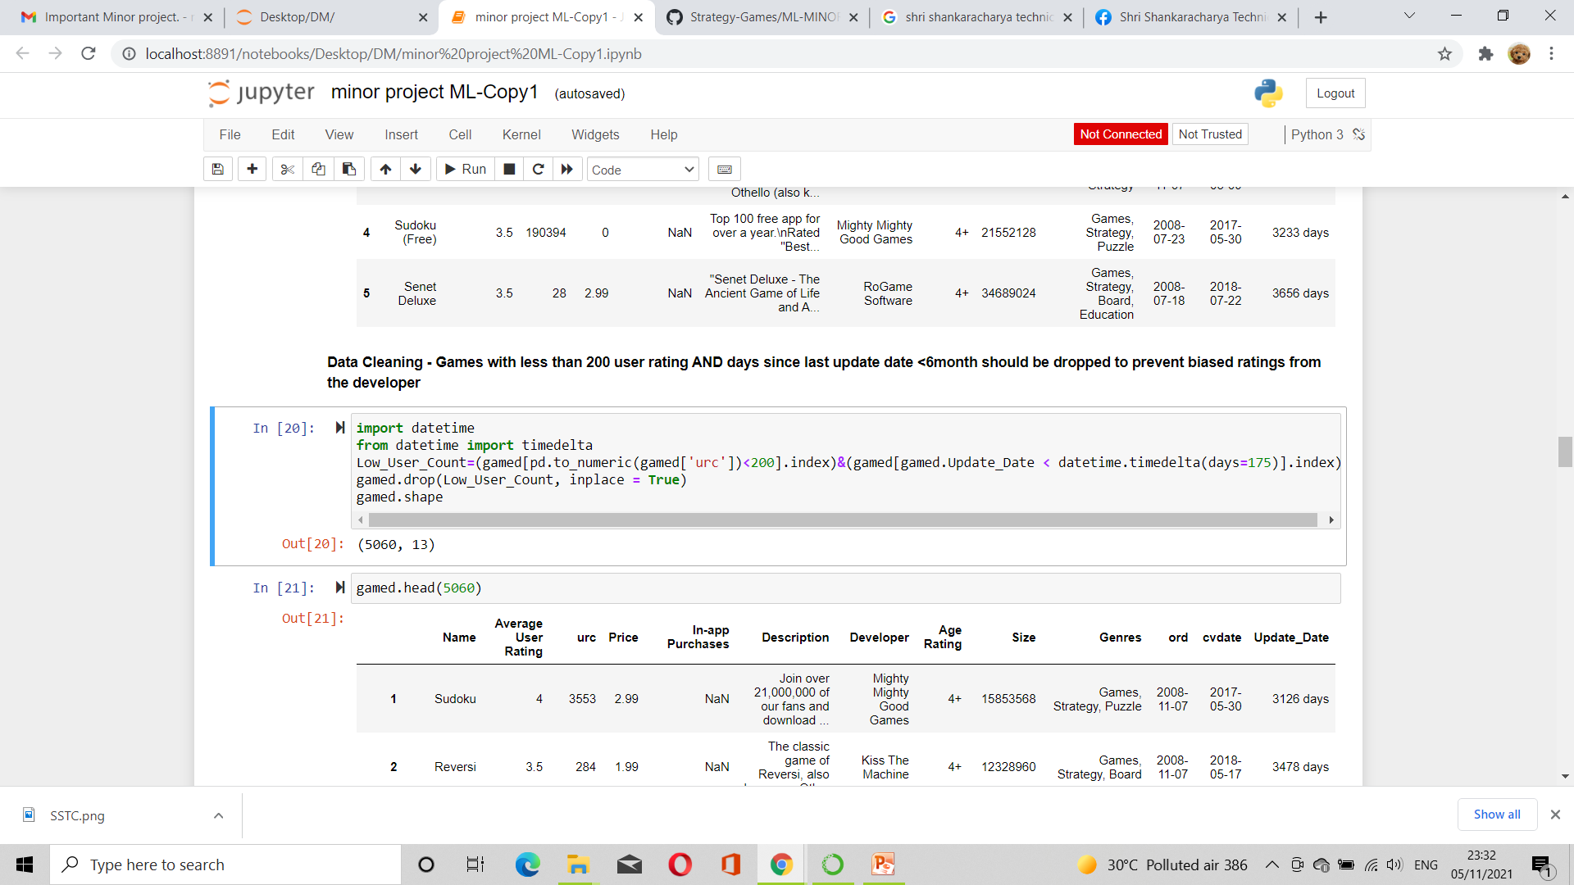
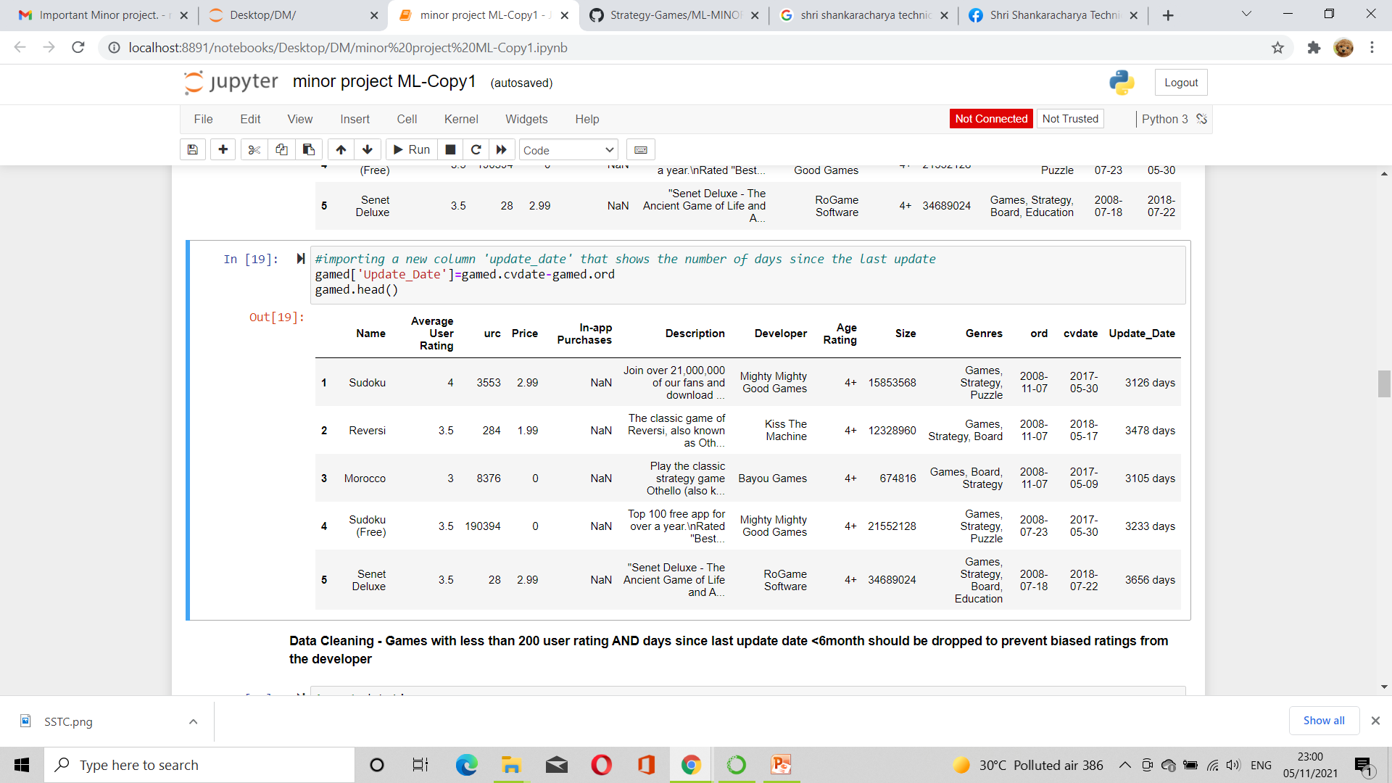
Games with less than 200 user rating AND days since last update date <6month are dropped:
Most expensive games are removed
Creating an Update date Columns

Slide 7
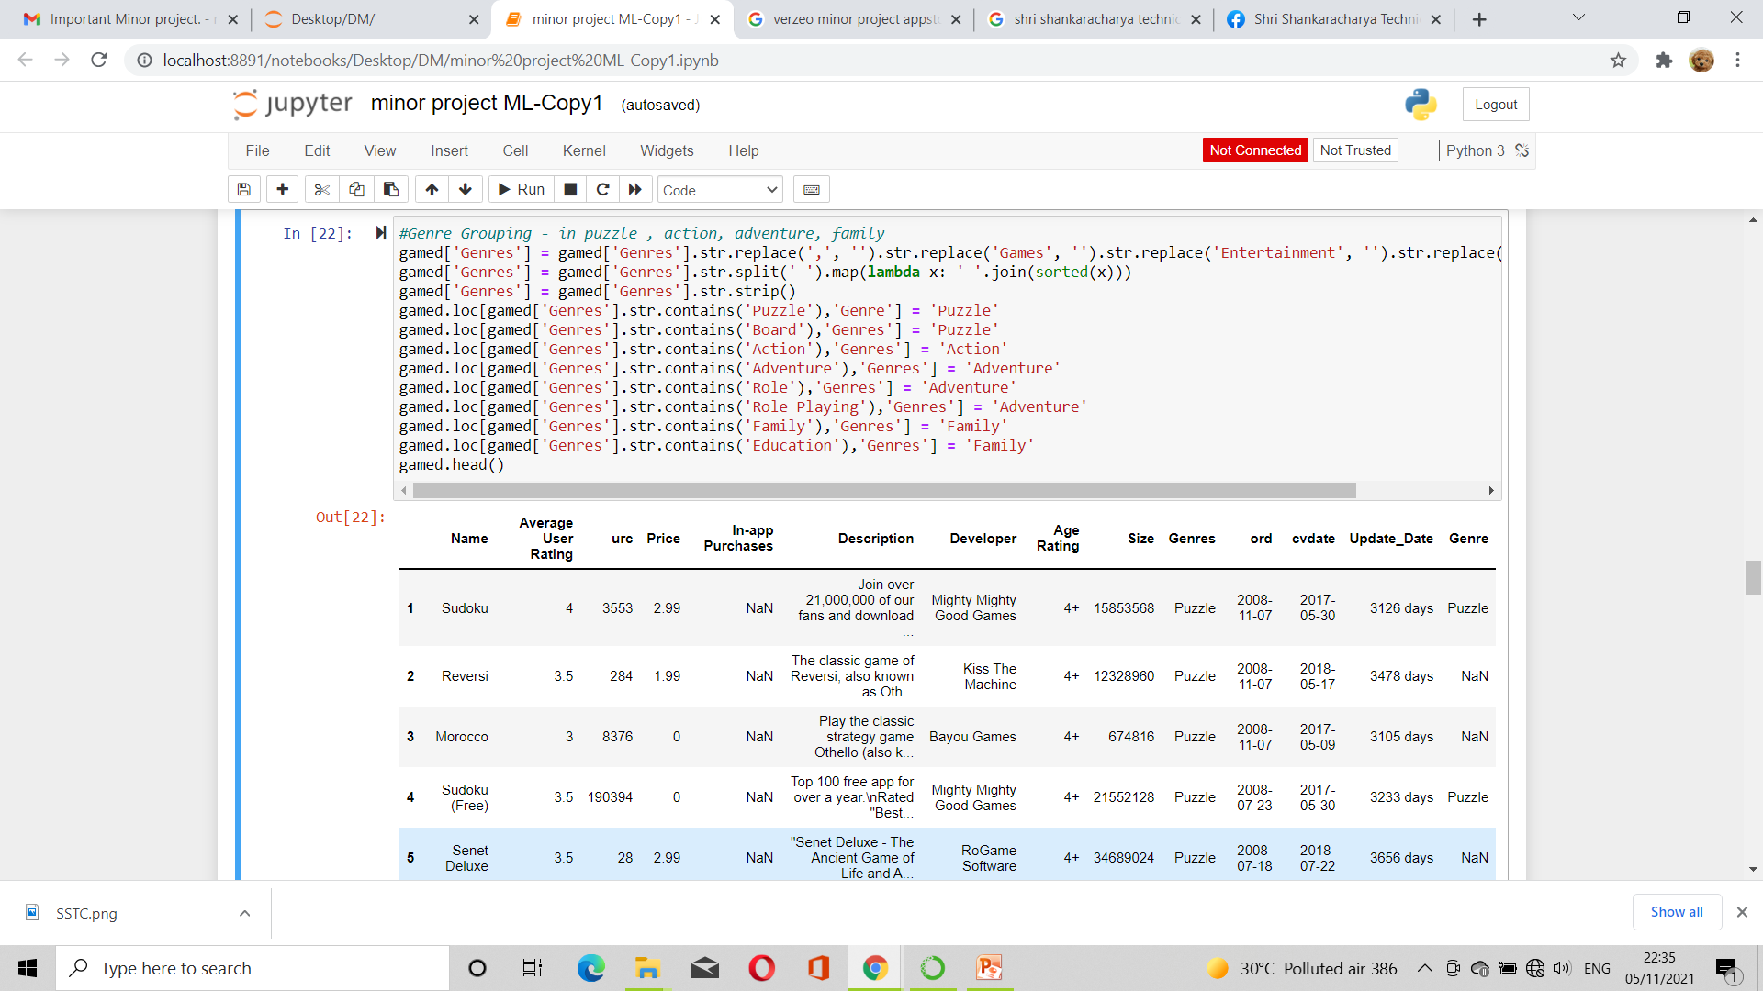
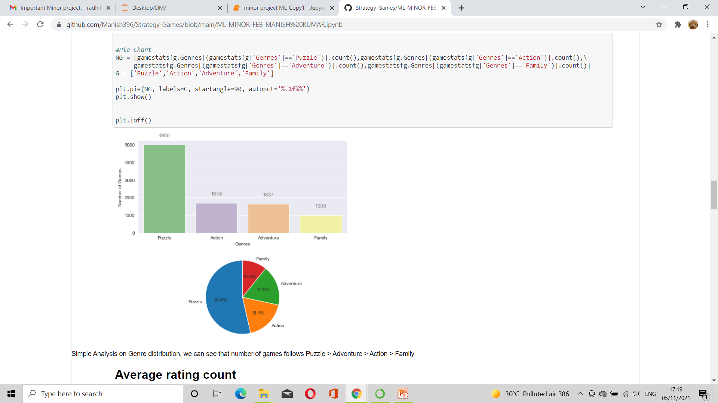
GENRE GROUPING
Notes:
<number>

Slide 8
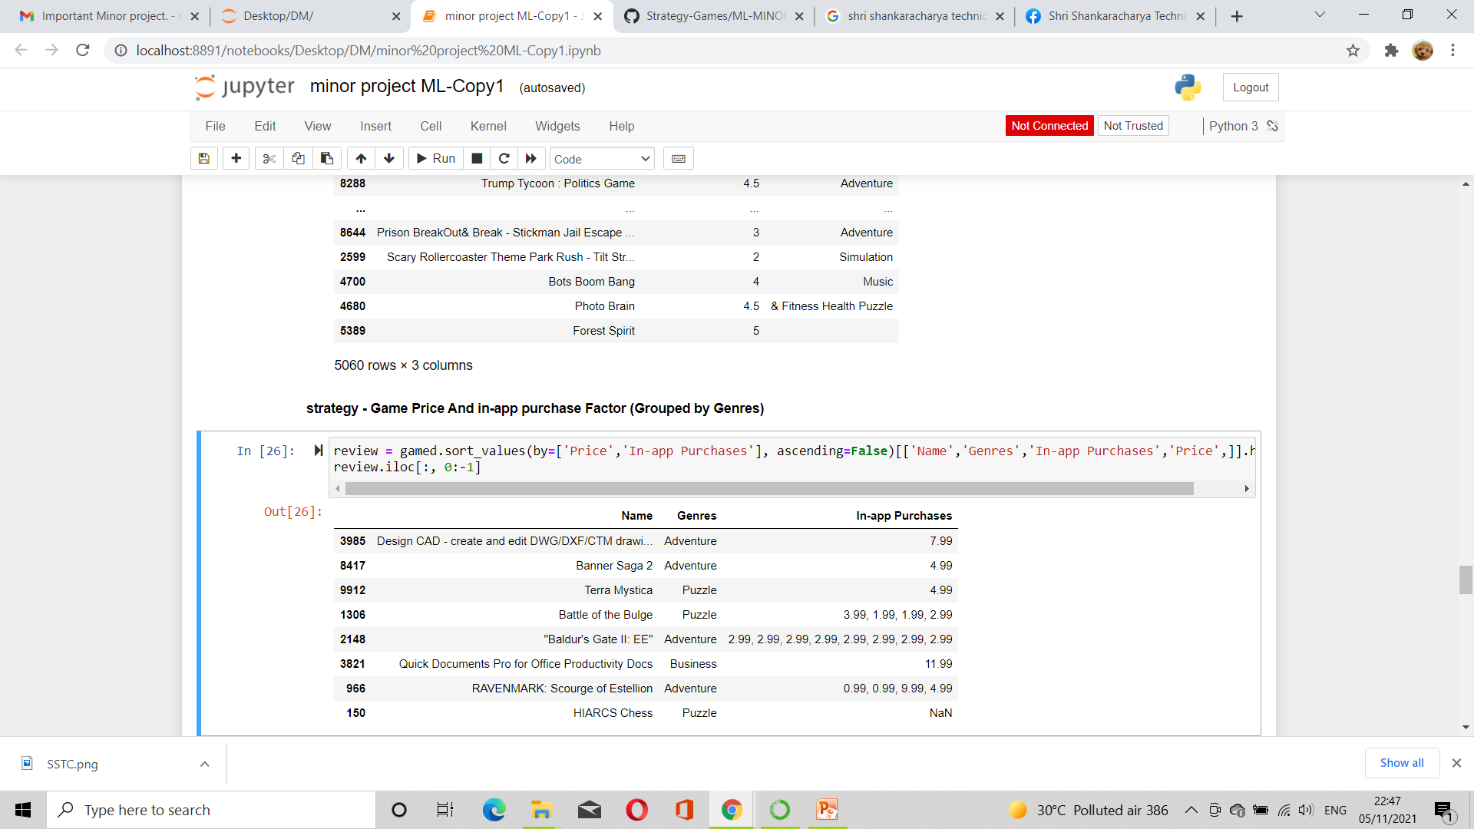
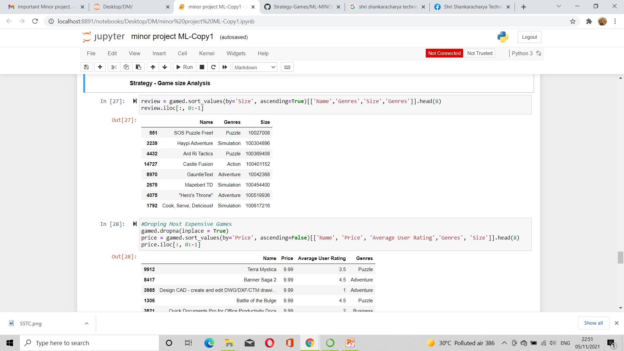
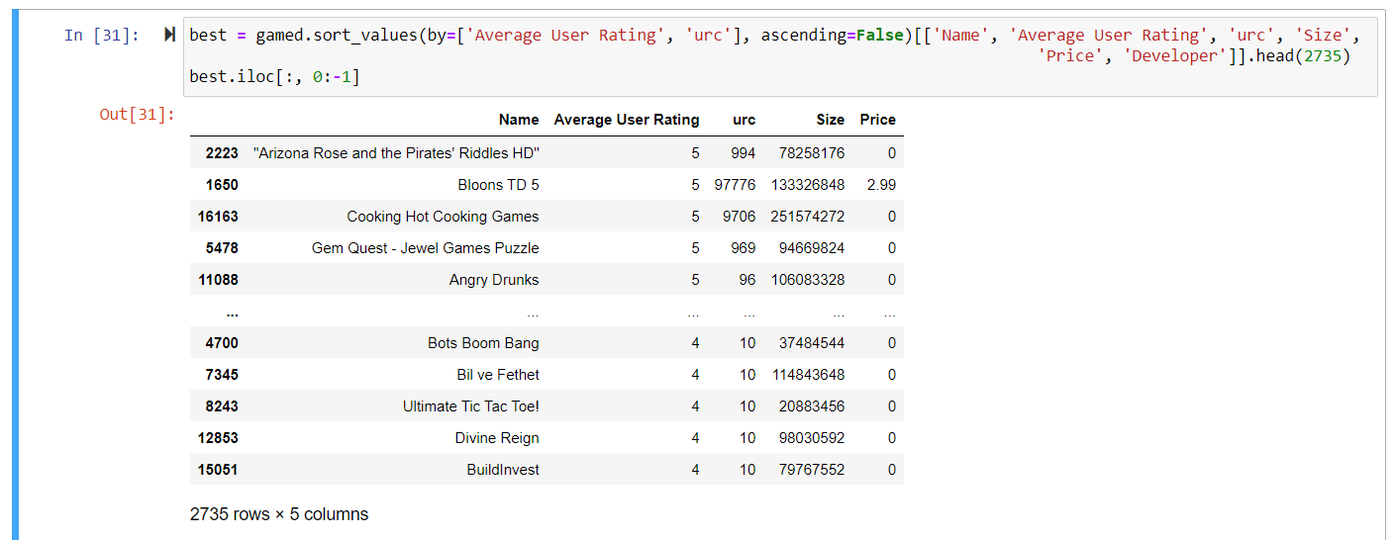
Game Price And in-app purchase Factor
(Grouped by Genres)
Game size Analysis
Final Result

Slide 9
Conclusion and Scope for Future Work
CONCLUSION RESULT OF PROJECT
There are 2735 games which have a user rating of 4 - 5.
The Genre having higher user rating are Puzzle , adventure and action.
The game having the highest user rating count is Bloons TD 5(Genre - Action).
FUTURE SCOPE
Makes it easier for user for finding which app is suitable for them.
User’s time can be saved.
Developer can do further modification according to need.

Slide 10
Thank You
Notes:
<number>

Slide 11
Strategy
Genre grouping
Game Size analysis
Release date/ Update date factor
Game Price and In-App Purchase Factor (Grouped by Genre)
Age Rating Factor
Data Cleaning
Games without User Rating should be dropped.
Perform Data Preparation by cleaning the data and removing null values.
Games with less than 200 user rating AND days since last update date <6month should be dropped to prevent biased ratings from the developer
Genre tags "Entertainment" and "Games" are removed from the Genre string as it does not provide meaningful insight
The remaining of the string are checked and grouped as follows:
Puzzle= Puzzle/Board
Adventure= Adventure/Role/Role Playing
Action = Action
Family = Family/Education
State your inferences.
Identify Which genres have higher user ratings.

